Slide 1
ROS topic, Node and Messages
Session 4

Slide 2
Node
Let’s start with something simple, turtlesim

Slide 3
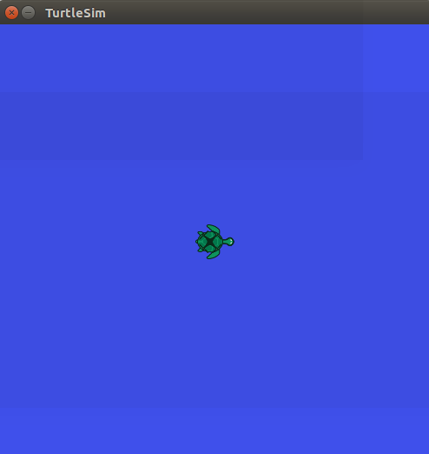
>> roscore
In a new terminal,
>> rosrun turtlesim turtlesim_node

Slide 4
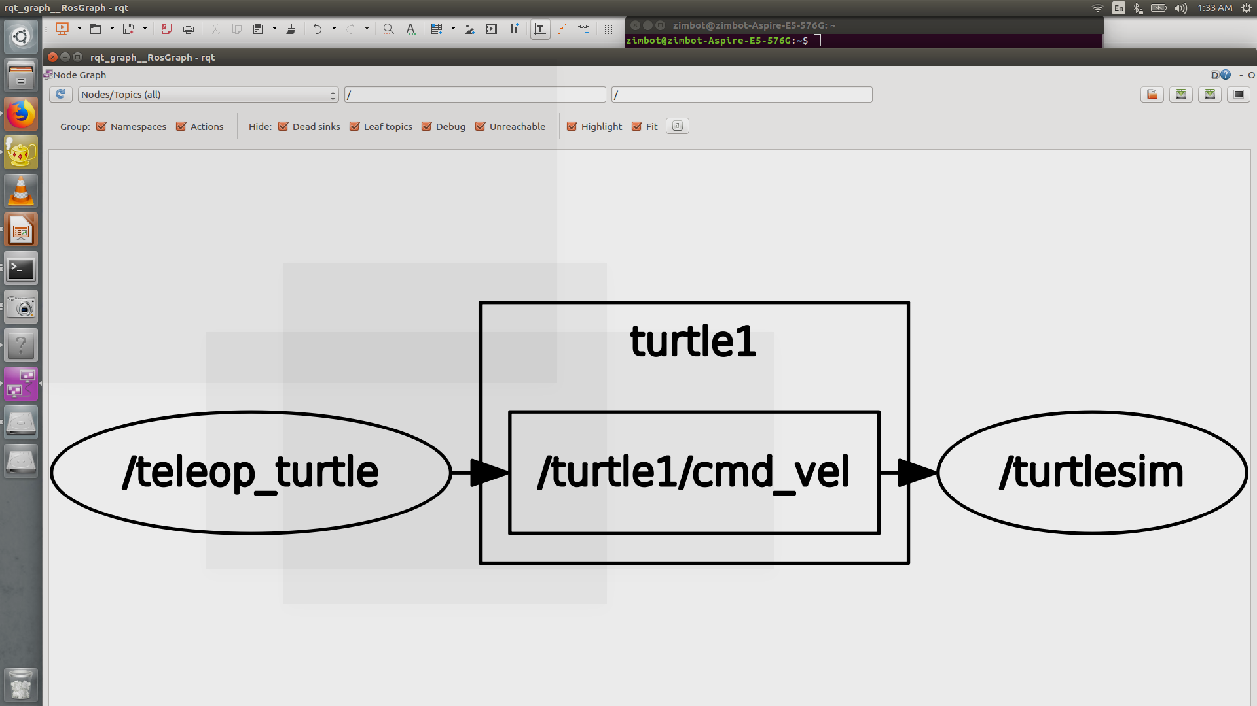
In a new terminal
>> rqt_graph
In a new terminal,
>> rosnode list – to visualize available nodes
CTRL + C
>> rostopic list – to visualize available topic
In a new terminal,
>> rosrun turtlesim turtle_teleop_key

Slide 5
Make sure the active window is the “rosrun turtlesim turtle_teleop_key”
Use arrow keys to move the turtle.

Slide 6
Node is like a function
Topic is the tunnel for data transmission
The relationship between Node and other node are connected with topic, and is unlimited
IMPORTANT – if there is no node, no topic can be transfer

Slide 7
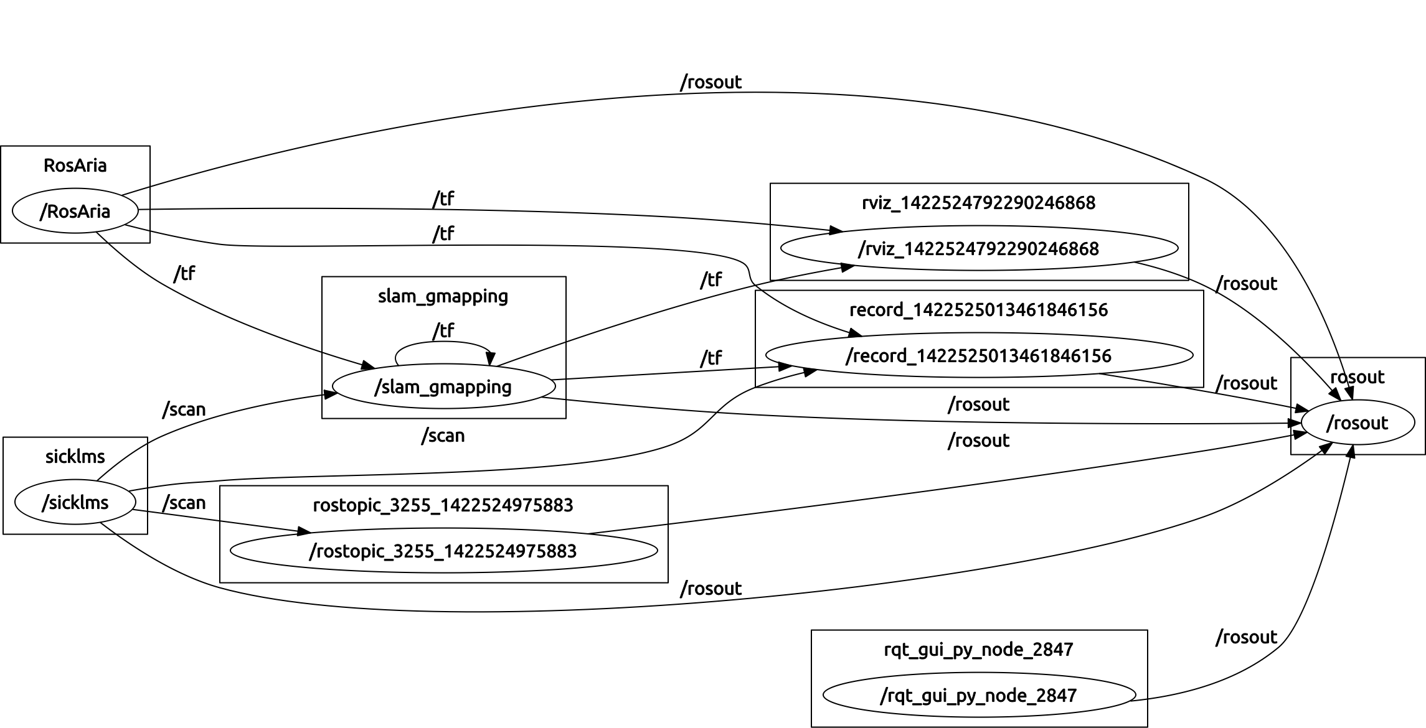

Slide 8
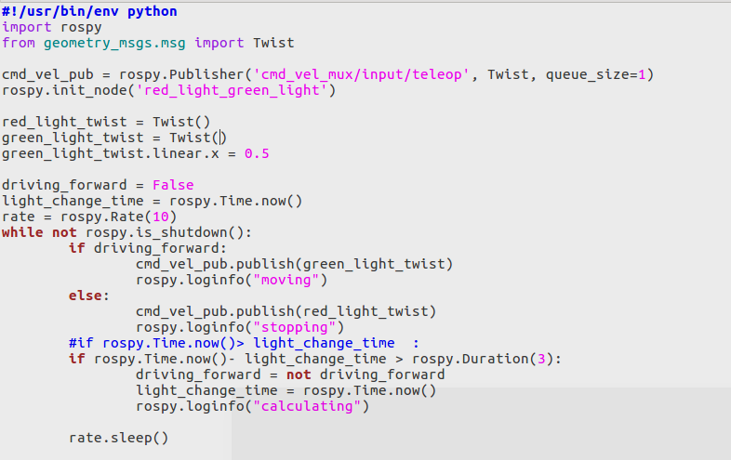
Publish and Subscribe

Slide 9
Two Ways to Publish
1. Use command
rostopic pub /topic_name
2. Use coding in python

Slide 10
Task
Create new file called message_pub.py in /innokai_workshop_ws/src/ros_basic/src

Slide 11
ROS topic, Node and Messages
Session 5

Slide 12
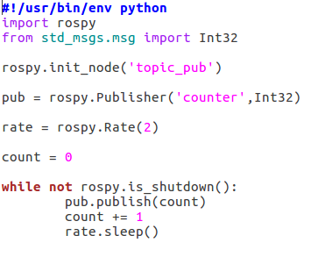
Publish
Publish means sending data/value
initiate node with node name
initiate Publisher with
Topic name
publish to Topic

Slide 13
>> chmod +x message_pub.py → Change Mode
make the file executable
In a new terminal
>> roscore (important, rosrun need to have a master node)
In a new terminal
>> rosrun ros_basic message_pub.py

Slide 14
In a new terminal
>> rostopic echo /counter
TASK
Initiate a node called “calculator”. Publish to topic “/result”
Calculate the difference of
Group 1 = 99, 88, 77 and Group 2 = 77, 88, 99

Slide 15
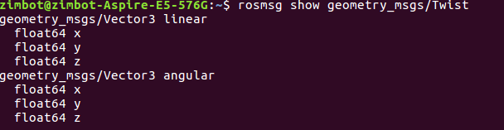
Twist Message Type
In a new Terminal
>> rosmsg show geometry_msgs/Twist

Slide 16
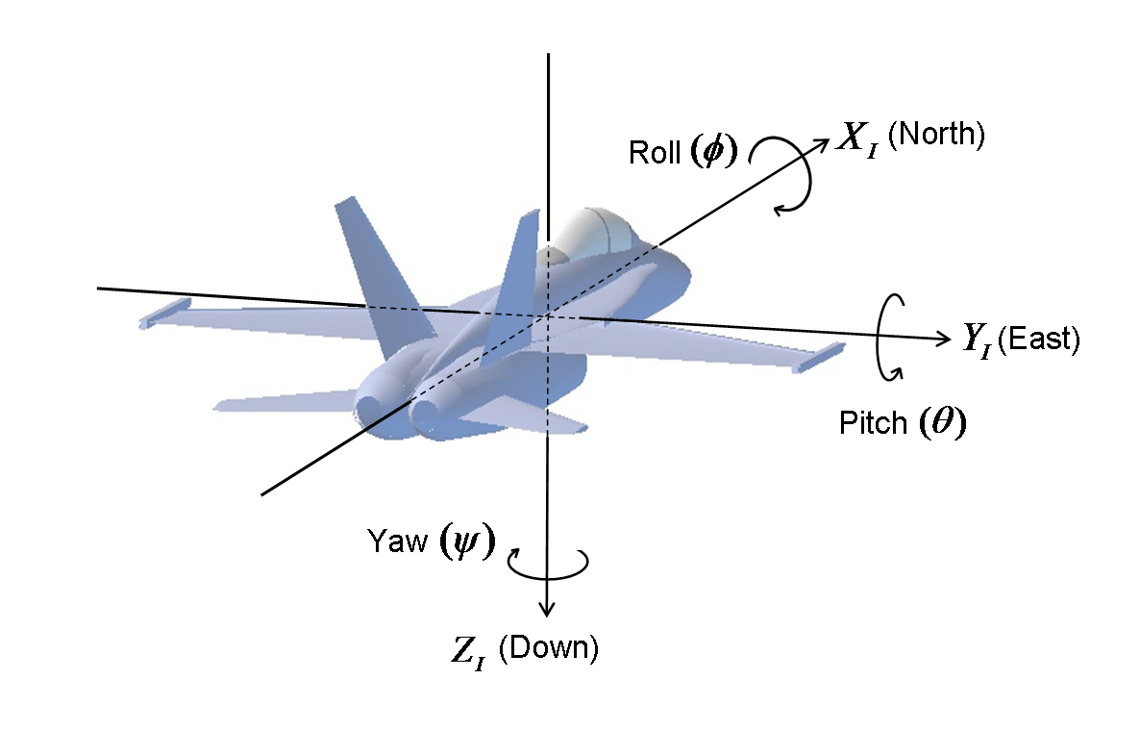
Twist Message Type
Linear velocities are specified in meters per second.
Angular velocities are given in radians per second.
For Turtlebot3, linear “x” is used for forward motion.
Angular “z” used for rotation.

Slide 17
Testing Twist in turtlesim
Modify these two values to have different motion
Use command
In a new terminal
>> rostopic pub /turtle1/cmd_vel geometry_msgs/Twt "linear:
x: 2.0
y: 0.0
z: 0.0
angular:
x: 0.0
y: 0.0
z: 0.0"

Slide 18
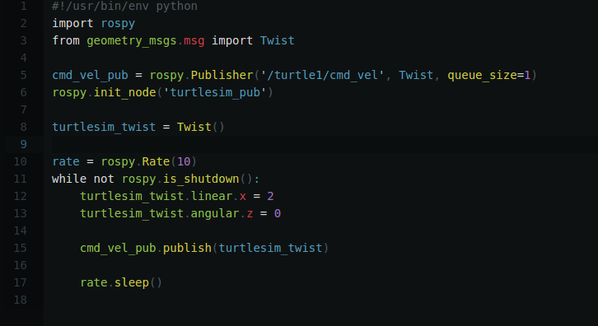
Use coding

Slide 19
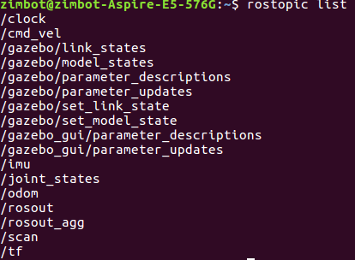
Turtlebot3 Navigation
In a new terminal
>> roslaunch turtlebot3_gazebo turtlebot3_world.launch
In a new terminal
>> rostopic list
*Tips, normal all robot use similar name
cmd_vel, velocity, etc

Slide 20
Turtlebot3 Navigation Publish
Use command
In a new terminal
>> rostopic pub /cmd_vel geometry_msgs/Twist "linear:
x: 0.0
y: 0.0
z: 0.0
angular:
x: 0.0
y: 0.0
z: 2.0"

Slide 21
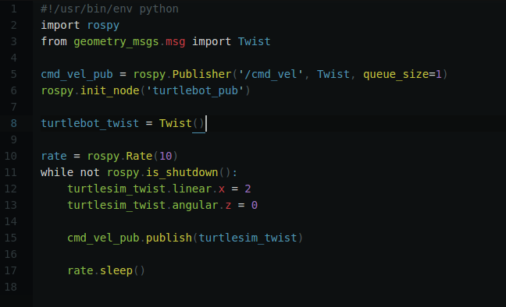
Use coding

Slide 22
Use Time and Duration in ROS
In programming, normally we CANNOT define how far can a robot go, we can define the duration of a robot move or how many rotation
Here we learn about time and duration
Rotation will not be cover in this session

Slide 23
Time and Duration arithmetic
1 hour + 1 hour = 2 hours (duration + duration = duration)
2 hours - 1 hour = 1 hour (duration - duration = duration)
Today + 1 day = tomorrow (time + duration = time)
Today - tomorrow = -1 day (time - time = duration)
Today + tomorrow = error (time + time is undefined)

Slide 24

Recall
rospy.sleep(duration)
ROS will sleep for the specified period
rospy.Rate(hz)
maintaining a particular rate for a loop

Slide 25

Timer
rospy.Timer(period, callback, oneshot=False)
Timer instance will attempt to call the callback every n seconds.

Slide 26
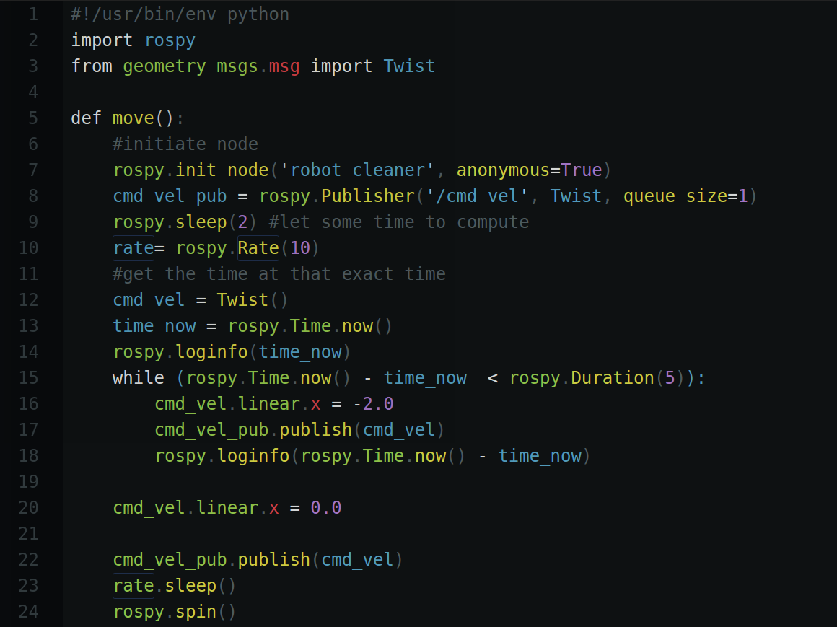
Example Usage
Move turtlebot3 forward for 10 sec

Slide 27
Task
Move your turtlebot forward for three second and stop for 2 second. In the end, spin 180°.

Slide 28
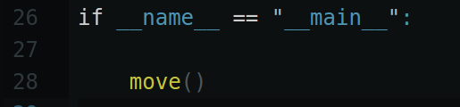

Slide 29
Subscribe
All the previous slide are about publish (send data)
Subscribe is about receiving data

Slide 30
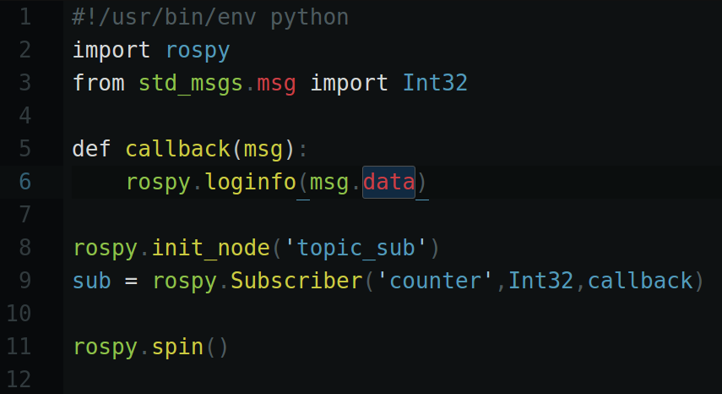
Subscribe
In src folder of ros_basic, create topic_subscriber.py and chmod +x it

Slide 31
Example
In two different terminal
>> rosrun ros_basic message_pub.py
>> rosrun ros_basic topic_subscriber.py

Slide 32
Usage
Callback function to process the data
Data source (topic name)
Data type receiving
Receive data from sensors
Receive data from nodes

Slide 33
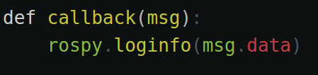
In bracket is the data, this case
we name it “msg”
Below is the coding to process the data

Slide 34
Task
Create two different .py file, one for publish while another one is subscribe
Topic
Send string “Hello World”
Subscribe
Print the data received
*(you may use print or rospy.loginfo)

Slide 35
Camera and Sensor Implementation
Session 6

Slide 36
Sensors
In ROS, many sensors are supported:
Camera, ultrasonic sensors, LDS, RGB-D camera, Touch Sensors, Gyroscope 3 Axis, Accelerometer 3 Axis, Magnetometer 3 Axis, etc.

Slide 37
Task
Move turtlebot forward until the distance in front is 1.0m

Slide 38
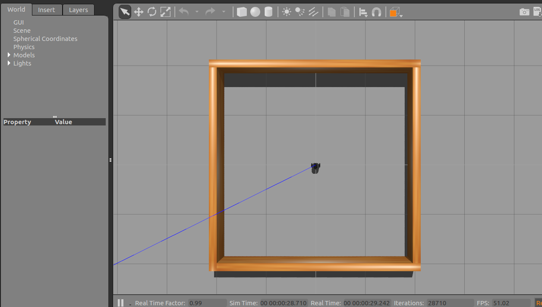
LDR Test
>> roslaunch turtlebot3_gazebo turtlebot3_stage_1.launch
In a new terminal
>> rosrun ros_basic ldr.py

Slide 39
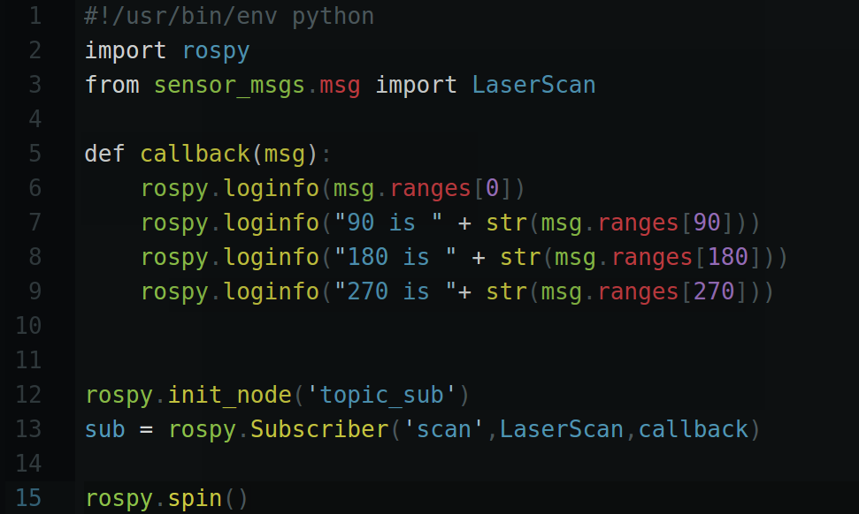
ldr.py

Slide 40
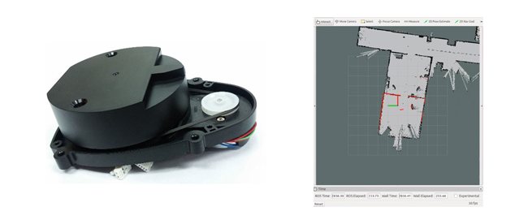
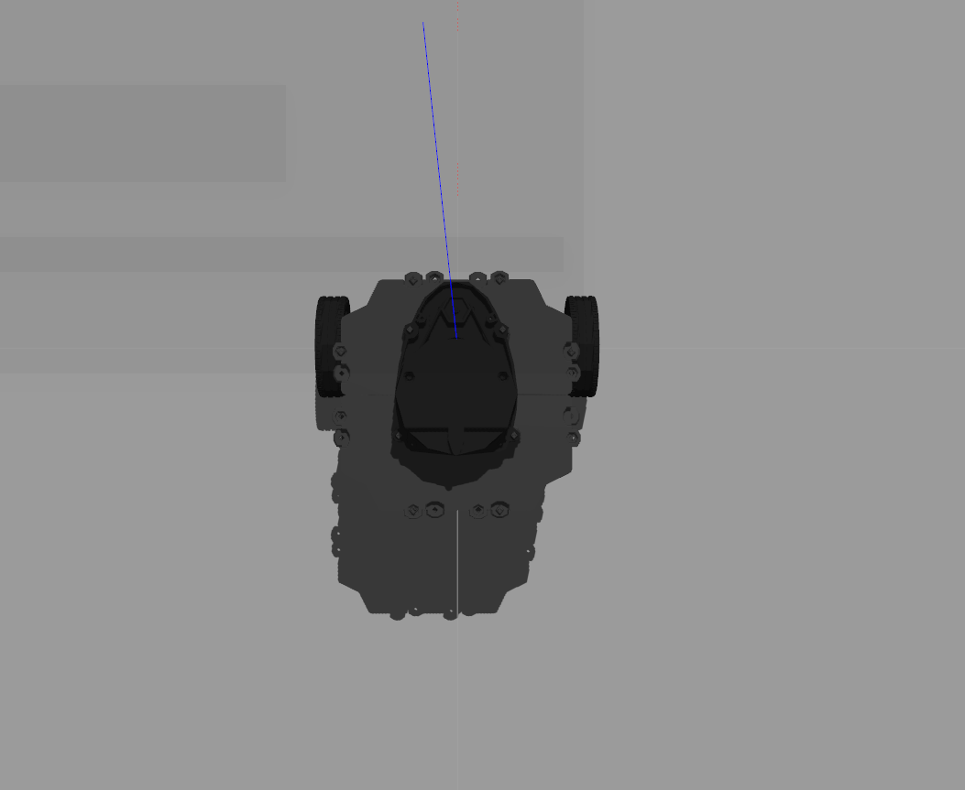
LDS(Laser Distance Sensor)
Data is read in these direction
360 Laser Distance Sensor LDS-01

Slide 41
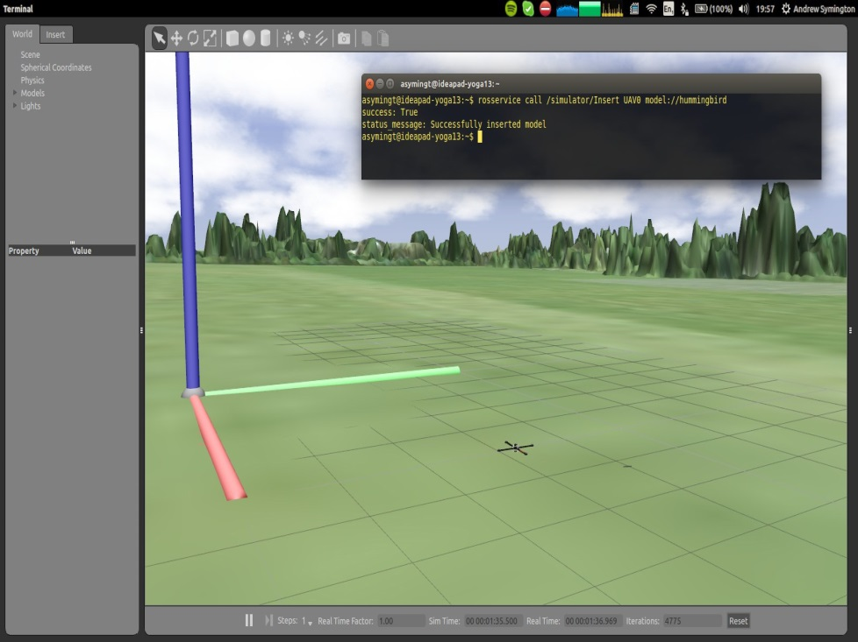
Computer vision in ROS
Standardized package manager
Runs on Ubuntu
Standardizes message-protocols for:
Pose estimation
Localization
Navigation
Computer vision
Incorporates the latest contributions from academia
Andrew Symington, UCL Gazebo and rviz with several quadrotors, ROSCon 2014

Slide 42
End of DAY 2
See you tomorrow

